Slide 1
HR System & Career Orientation
FSOFT Human Resource Department

Slide 2
OBJECTIVES
Outline preliminary understanding of FSOFT Organizational structure
Overview of FSOFT HR policies and procedures as well.

Slide 3
CONTENTS
Part I: Working time & Company regulations
Part II: Organizational structure
Part III: HR policies and procedures
Part IV: Email Guideline
No. | Context | No. | Context
1 | Job System and career development | 7 | Compensation
2 | Staff level | 8 | Benefit
3 | Training & development | 9 | Overtime policy
4 | Performance appraisal | 10 | Employee profile
5 | Labor Contract | 11 | Personal income tax
6 | Resignation

Slide 4
PART I: WORKING TIME & COMPANY REGULATIONS

Slide 5




1. WORKING TIME
From Monday to Friday:
Saturday morning: be off if have no urgent task or supervisor’s requirement.

Slide 6
2. COMPANY REGULATIONS
Nội quy Lao động/ Labour Regulation
Thỏa ước Lao động tập thể/ Collective Labour Agreement
Nội quy Công ty/ Regulation of the Company
Nội quy phòng cháy chữa cháy/ Rules of fire safety
Quy định Bảo mật thông tin/ Information security Regulation
Quy định về Thời giờ làm việc/ Working time Regulation
Quy định về An toàn nghỉ mát/ Summer vacation Regulation
Quy định về Chế độ nghỉ/ Absence Regulation
Quy tắc đạo đức nghề nghiệp/ Professional ethnics rules

Slide 7
PART II: FSOFT ORGANIZATION

Slide 8
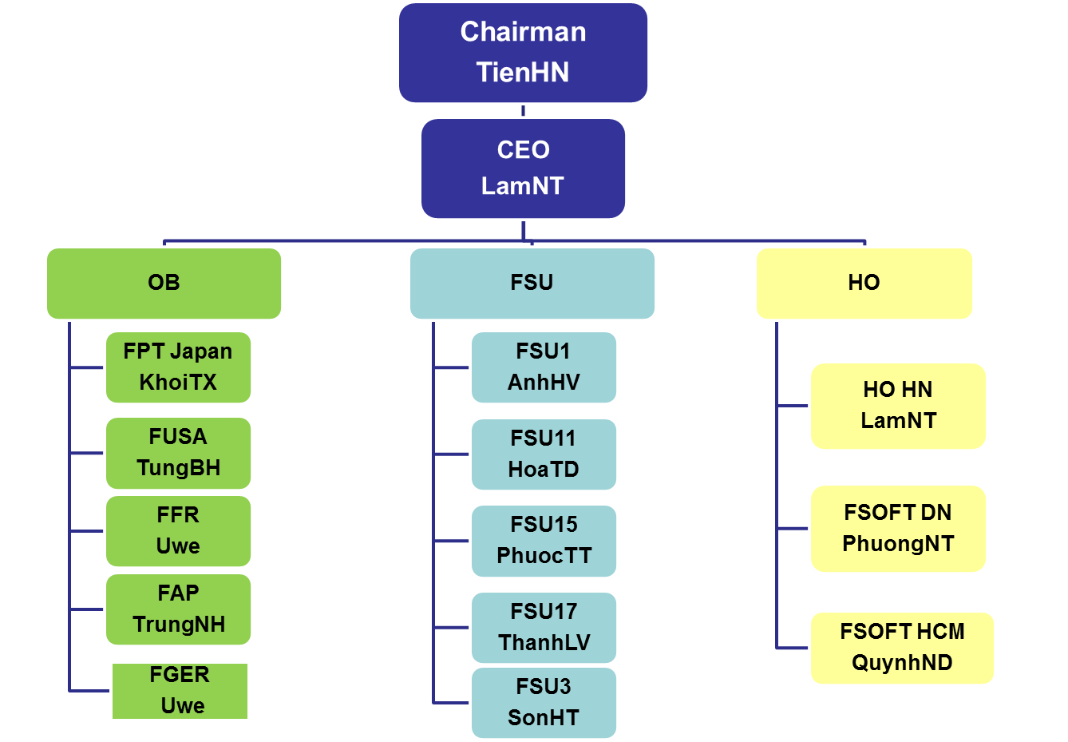



ORGANIZATION CHART
Chú thích:

Slide 9
ORG CHART - FSOFTHCM
CHAIRMAN
TuanPM
CEO
QuynhND
FSU3
FSU15
FSU17 HCM
FSU11 HCM
FSB DMS
FSU1
HCM
BA HCM
DMS
BU0
BU9
BU5
BU3
AD
JCD HCM
BU8
DNM
BU1
BU6
AF
QA HCM
SMC
BU2
GA HCM
BU19
QA
GA
BU3
BSD
BU36
IAD
QA
GA
GA HCM
QA HCM
IT
JCD
FWA
QA

Slide 10
ORGANIZATION CHART
DELIVERY:
Develop products and assure the quality and timeliness of the products
SALES:
- Do sales and marketing activities and get work order from clients
BUSINESS ASSURANCE
To support Delivery and Sales Units, makes sure that units have proper
infrastructure to do business

Slide 11
PART III: HR POLICIES AND PROCEDURES

Slide 12
1. JOB SYSTEM AND CAREER DEVELOPMENT
Job System - Delivery
Professional Stream |  |  |  |  |  |  |  | Mgmt Stream
DEV | TEST | COMTOR | BrSE | BA | SA | PM | QA | Comtor Mgr | QA Mgr | Vice BUL | BUL
DEV1 | TEST1 | COMTOR1 |  |  |  |  | QA1
DEV2 | TEST2 | COMTOR2 |  | BA1 |  |  | QA2
DEV3 | TEST3 | COMTOR3 | BrSE1 | BA2 |  | PM1 | QA3
DEV4 | TEST4 | COMTOR4 | BrSE2 | BA3 | SA1 | PM2 | QA4 |  |  | Vice BUL1
 |  |  | BrSE3 | BA4 | SA2 | PM3 |  | Com Mgr 1 | QA Mgr 1 | Vice BUL2 | BUL1
 |  |  | BrSE4 |  | SA3 | PM4 |  | Com Mgr 2 | QA Mgr 2 | Vice BUL3 | BUL2
 |  |  |  |  |  | PM5 |  |  |  |  | BUL3

Slide 13
1. JOB SYSTEM AND CAREER DEVELOPMENT
Job System – Back office
Professional Stream |  |  |  |  |  |  |  | Mgmt Stream
ADO | HRO | ACCO | COM | LEG | IT | ISM | SAL | HRM | ADM | ACCM | SALM
ADO1 | HRO1 | ACCO1 | COM1 | LEG1 | IT1 | ISM1 | SAL | HRM1 | ADM1 | ACCM1 | SALM1
ADO2 | HRO2 | ACCO2 | COM2 | LEG2 | IT2 | ISM2 | SAL | HRM2 | ADM2 | ACCM2 | SALM2
ADO3 | HRO3 | ACCO3 | COM3 | LEG3 | IT3 | ISM3 | SAL | HRM3 | ADM3 | ACCM3 | SALM3
Job rank reflects qualifications of employees (skills, knowledge and experience) and defined when hiring.
Staff develop his/ her career by increasing Job rank.
Each Job rank has a range of income package.

Slide 14
2. STAFF LEVEL
Staff level engages to Job rank/ position and indicates their importance as well in organization.
An employee is classified into a staff level by the following cases:
Being promoted/demoted
Change job rank.
Change contract
Other special cases.
Level system: have 7 levels and 19 sub levels.

Slide 15
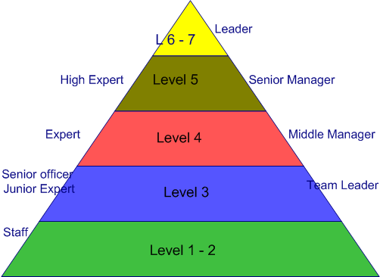
2. STAFF LEVEL

Slide 16
3. TRAINING & DEVELOPMENT
Training program based on:
Organization need (Fresher training)
Job need
Individual need.
Sponsor for general course, professional certificate: maximum 100%, up to approval of Head of Unit and training budget.
Notes:
16

Slide 17
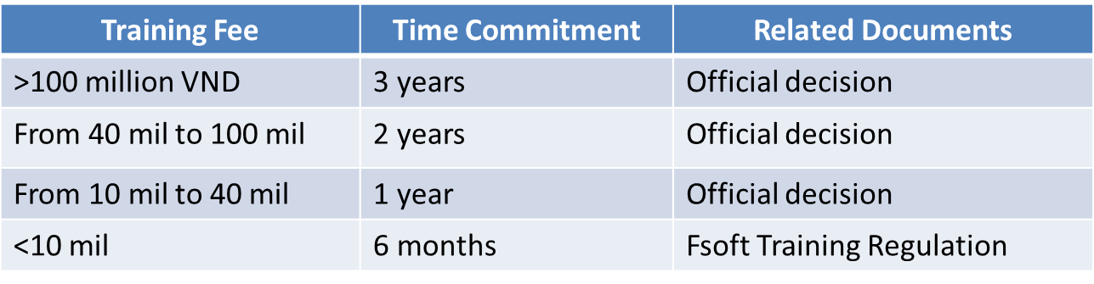
3. TRAINING & DEVELOPMENT
Training commitment:
Time Commitment– Working time after course
Compensation amount= x Training Fee
Time Commitment

Slide 18
EMPLOYMENT: Recruitment & Selection
Process
Application screening
Entry test: IQ, GMAT, English, Professional Competences
Interviews (selection and offer interviews)
Probation period (ORT course & Entry re-test, if any)

Slide 19
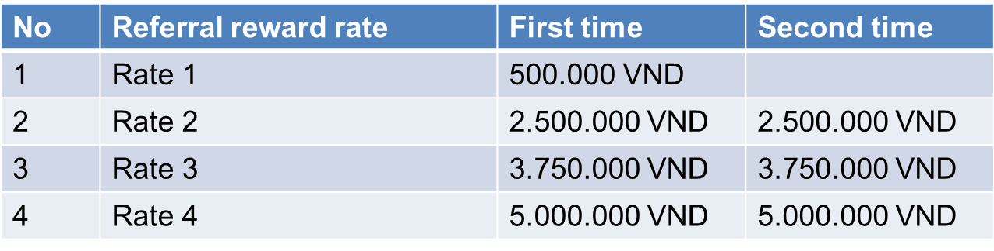
EMPLOYMENT: Recruitment & Selection
Referral Incentive Program
The above rates is defined on basis of negotiable salary rate between an employee and the company.
Referral reward would be paid in 2 times:
The first payment is when candidate introduced signs trial contract and
Secondly payable only if candidate introduced has signed short-term contract for 4 months

Slide 20
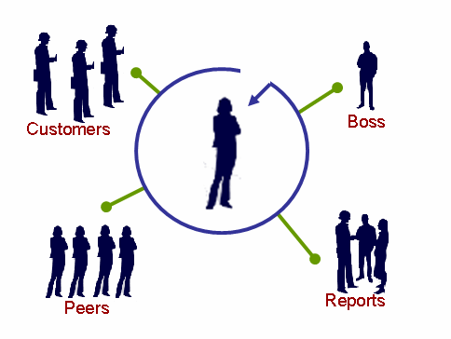
4. PERFORMANCE APPRAISAL
What?
Employee Evaluation system of FSOFT (CHE)
Why?
Review the employee’s performance in last period;
Offer 2-way communication of employee performance;
Create next working plan;
Base for reward and career development
When?
Twice per year by Jun and Dec
What would be appraised?
Last performance
Intellectual contribution
Personal development
Social activities
Reward & penalty

Slide 21
5. LABOR CONTRACT
Duration
Temporary Contract
Permanent Contract
Duration
2 months
Probation Contract
Short-term Contract
6 months
< 3 months
Seasonal
Labor Contract
Long-term Contract
12-36 months
Apprentice Contract
Term-less Contract

Slide 22
6. RESIGNATION
Contract termination informed officially in advance:
7 days: Temporary Contract
15 days: 6-month contract
30 days: 3-year contract
45 days: Term-less contract
Fine of contract break will be given to those
Do not inform timely and,
Invalid reasons for termination of labor contract
Handover:
Work/Task List
Facilities: computer, account, access card, debt, book…

Slide 23
7. COMPENSATION
Compensation philosophy:
Market competitiveness
Differentiation by performance
Pay for actual contribution (actual value)
Compensation Structure:
Base salary:
Noted in labor contract
For mandatory insurance, union fee
Severance allowance
Performance salary: F salary table, based on capability, experience and level of employee.

Slide 24

7. COMPENSATION
Allowance: transportation, mobile & internet; based on job’s need (e.g.: admin, sale,…)
The 13th Salary
Soft Salary: for L1-L4, based on Job rank and qualification of Job assigned.
Bonus: for L5 up and key person, based on individual and company’s performance.
Salary review:
Base on Checkpoint result (in Aug & Feb)
End of contract
Be promoted or demoted

Slide 25

8. BENEFIT
Health check
Summer vacation
FPT Care
Team-building
Events: Women day, Men day, 13/9, ….
Leaves: annual leave, holidays, sick leave, marriage leave, unpaid leave,…

Slide 26
9. OVERTIME POLICY
Applied for staff who hold level 3 down
Overtime: starts from 45th hrs. onward and happens on Saturday, Sunday, Holiday
Regime:
Allowance
Compensated leave

Slide 27
10. EMPLOYEE PROFILE
No | Documents list | Require
1 | Curriculum Vitae in Vietnamese template within 6 months certified by local authority/ university (a notarized copy accepted) | Man
2 | Notarized copies of diplomas/ professional certificates | Man
3 | Copy of ID card (Copy of passport/ Driving License in replacement) | Man
4 | Health certificate within 6 months issued by a city-level hospital (a notarized copy accepted) | Man
5 | Birth certificate (a notarized copy accepted) | Man
6 | Curriculum Vitae in English | Man
7 | Application Letter in English | Opt
8 | 2 (4x6) photos (within 6 months) | Man
* Delay signing Trial contract if mandatory profiles haven’t been submitted no later than the first day of Day 1

Slide 28
11. PERSONAL INCOME TAX
“Thu nhập chịu thuế”
“Thu nhập tính thuế”
“Giảm trừ gia cảnh”
Personal income tax settlement
Accumulated taxable income:
Grade | Taxable income/ year (million VND) | Taxable income/ month (million VND) | Tax rate (%)
1 | <= 60 | <= 5 | 5
2 | > 60 and < = 120 | > 5 and < = 10 | 10
3 | > 120 and <= 216 | > 10 and <= 18 | 15
4 | > 216 and <= 384 | > 18 and <= 32 | 20
5 | > 384 and <= 624 | > 32 and <= 52 | 25
6 | > 624 and <= 960 | > 52 and <= 80 | 30
7 | > 960 | > 80 | 35

Slide 29
Part 4: Email guideline

Slide 30
Email Guideline
Writing email:
Write well-structured emails and use short, descriptive subjects.
Start an e-mail with ‘Hi’, or ‘Dear’, and the name of the person. Messages can be ended with ‘Best Regards’.
Signatures must follow format indicated by Company.
Use the spell checker before you send out an email.
Use cc, bcc, forward email if the recipients relate to and understand their role.
Only mark emails as important if they really are important

Slide 31
Email Guideline
Replying to emails:
Emails should be answered within at least 8 working hours.
Only use email account of company or use email account that customers request to use for works.
“Importance Notice” is required to be added underneath the sender’s signature, especially for outgoing message.

Slide 32
Master list: \\10.16.34.100\Fsoft-QMS\Document
THANK YOU

